Slide 1

Burger Breakout

Slide 2
Overview of Burger Breakout
2D Side Scroller
Featuring running, jumping, fighting, and climbing
Escape the kitchen through various levels playing as a burger
Each level will have different types of obstacles
Throw food and drinks at enemies to help breakout
Watch out for boss fights!
Advance through the levels to unlock different items
Enjoy some catchy background music while playing
Retro pixel theme delivers a nostalgia overload
Hypnotic gameplay with mesmerizing visuals

Slide 3
What Sets Burger Breakout Apart from the Others
Unique Theming:
Fast food themed levels and attacks
Most food games involve cooking
Variety of attack types
French Fries
Lettuce (wraps up an enemy)
Soda (makes an enemy slip)
Multiple different styles of levels
“Run and Gun” to an exit
Auto-scrolling
Platforming to an exit
Run away from a non-playable character (NPC) so you don’t get eaten

Slide 4
Some Example User Stories
As a player I want to be able to shoot food so that I can defeat my enemies.
The burger character will be able to shoot different types of food at enemies which complements the game theme and provides a unique game mechanic.
As a player I want to have a character that I can control so that I can move through the world.
The player’s character will be a hamburger that they can control with their inputs.
As a player I want my character to have animations so that the controls feel more realistic.
The character will have basic animations using sprite sheets to give a more realistic, yet retro feel to the game.

Slide 5
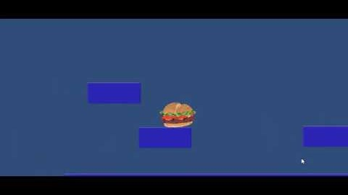
Early mock-up
Still in the early development stage and will add the following features:
Mechanics
Enemies
Hazards
Scenery

Slide 6

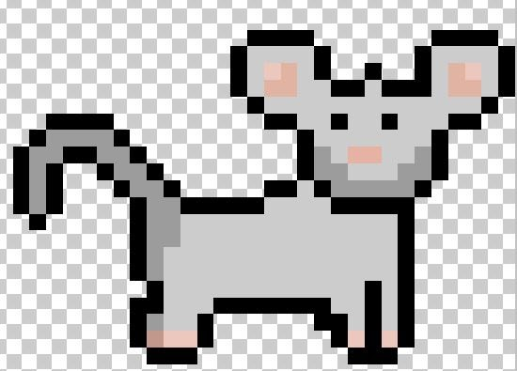

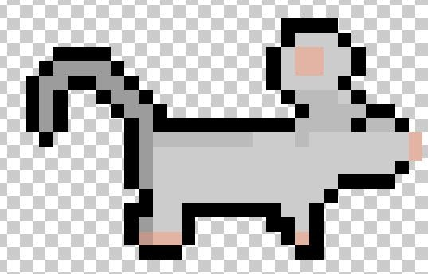
Early Concept Art: Characters
Main Character – needs to be named
Mouse NPC
Hot Dawg Boss –Sausage link Nunchaku wielding

Slide 7




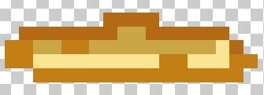

Early Concept Art: Throwable Items
Lettuce
French Fries
Bottom: Fry-a-rang
Fountain Drink

Slide 8


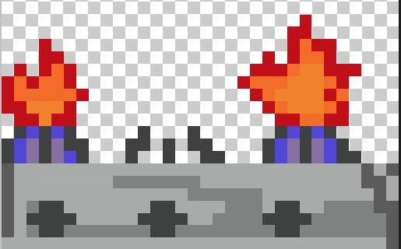

Early Concept Art: Hazards
Dropped Food
Tomato Slices
Timed Jumps Across Kitchen Burners
Knives Being Used by Humans

Slide 9

Questions/Comments/Complaints?

